Slide 1
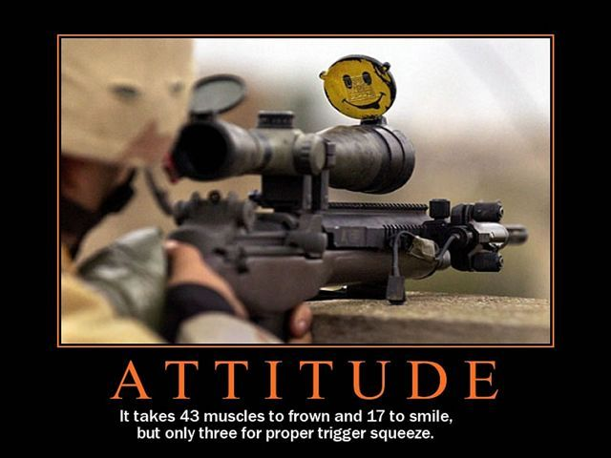

Slide 2
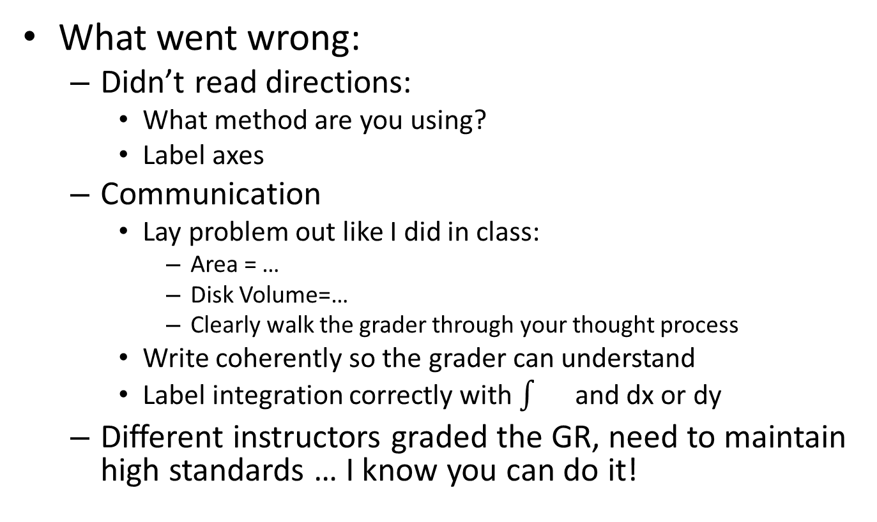
GR
What went wrong:
Didn’t read directions:
What method are you using?
Label axes
Communication
Lay problem out like I did in class:
Area = …
Disk Volume=…
Clearly walk the grader through your thought process
Write coherently so the grader can understand
Label integration correctly with and dx or dy
Different instructors graded the GR, need to maintain high standards … I know you can do it!

Slide 3
Math 152 – Lesson 13
Lesson | Topic | Reading
12 | Integration by Parts | 7.1
13 | Integration of Rational Functions by Partial Fractions | 7.4
14 | Improper Integrals | 7.8
Objectives:
Understand that Integration by Parts (IBP) is derived from reversing product rule derivatives
Recognize when IBP is an appropriate for evaluating an integral
Evaluate a given integral using IBP

Slide 4
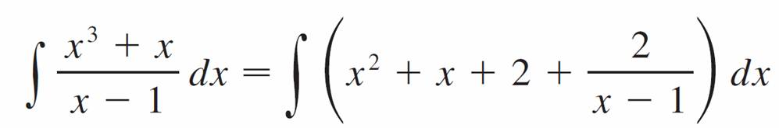
Proper Function
If numerator is a higher degree polynomial, then divide the numerator by the denominator:

Slide 5

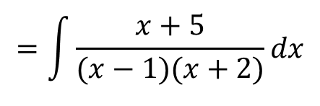
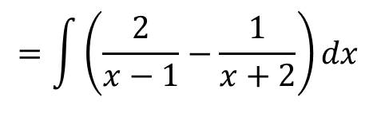

Partial Fractions
Break fractions up into simpler pieces for integration
Look at the following cases:
Case 1: no repeated roots
Case 2: repeated roots
Case 3: irreducible quadratic factors
$$\int{\frac{x+5}{x^{2}+x−2}dx}$$
$$=\int{\frac{x+5}{(x−1)(x+2)}dx}$$
$$=\int{\left(\frac{2}{x−1}−\frac{1}{x+2}\right)dx}$$
$$=2ln\left|x−1\right|−ln\left|x+2\right|+C$$
Notes:
7.4, p484 example
Plot
(x+5)/((x-1)(x+2))
2/(x-1)-1/(x+2)

Slide 6
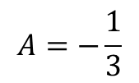
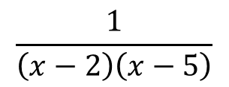

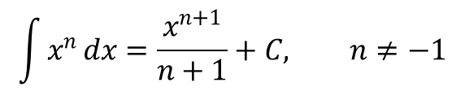
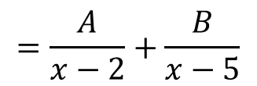
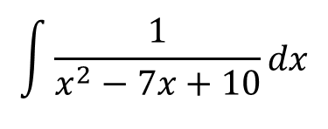

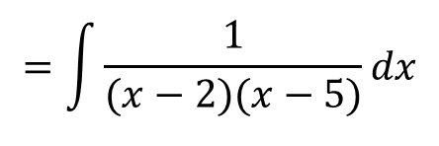
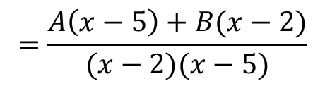
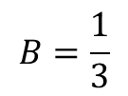

Partial Fractions (Case I)
$$\int{\frac{1}{x^{2}−7x+10}dx}$$
$$=\int{\frac{1}{(x−2)(x−5)}dx}$$
$=\int{[\frac{−1/3}{x−2}+\frac{1/3}{x−5}}$ ]$dx$
$$=−\frac{1}{3}\int{\frac{1}{x−2}}dx+\frac{1}{3}\int{\frac{1}{x−5}}dx$$
$$\frac{1}{\left(x−2\right)\left(x−5\right)}$$
$$=\frac{A}{x−2}+\frac{B}{x−5}$$
$$=\frac{A\left(x−5\right)+B(x−2)}{(x−2)(x−5)}$$
$$1 =A\left(x−5\right)+B(x−2)$$
$$for x=2, 1 =A\left(2−5\right)+B(2−2)$$
$$A=−\frac{1}{3}$$
$$for x=5, 1 =A\left(5−5\right)+B(5−2)$$
$$B=\frac{1}{3}$$

Slide 7

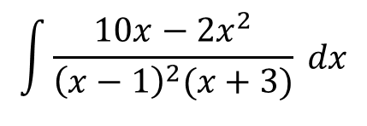





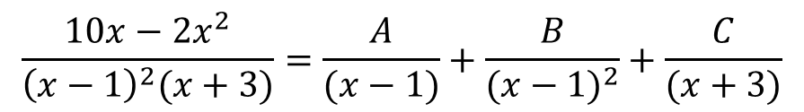
Repeated Linear Factors (Case II)
$$\int{\frac{10x−2x^{2}}{{\left(x−1\right)}^{2}(x+3)} dx}$$
$$\frac{10x−2x^{2}}{{\left(x−1\right)}^{2}(x+3)}=\frac{A}{(x−1)}+\frac{B}{{(x−1)}^{2}}+\frac{C}{(x+3)}$$
$$10x−2x^{2}=A\left(x−1\right)\left(x+3\right)+B\left(x+3\right)+C{(x−1)}^{2}$$
$$10x−2x^{2}=x^{2}(A+C)+x\left(2A+B−2C\right)+{(−3A+3B+C)}^{}$$
$$A + C=−2$$
$$A =1$$
$$2A+B−2C=10$$
$$B =2$$
$$−3A+3B+C=0$$
$$C =−3$$
Notes:
Example 4, p 488 (10x-2x^2)/((x-1)^2(x+3))
1/(x-1)+2/(x-1)^2-3/(x+3)
Add: 4B = 8
B = 2
$−2(A + C=−2$)
($2A+(2)−2C=10$)
0A + 2 – 4C = 14
C = -3
$(A + (−3)=−2)$, A = 1

Slide 8

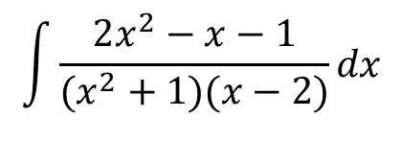




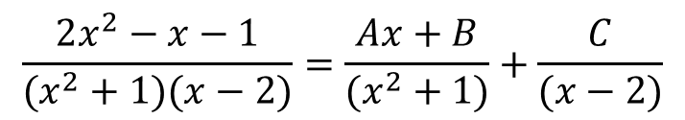
Irreducible Quadratic Factor (Case III)
$$\int{\frac{2x^{2}−x−1}{(x^{2}+1)(x−2)}dx}$$
$$\frac{2x^{2}−x−1}{(x^{2}+1)(x−2)}=\frac{Ax+B}{(x^{2}+1)}+\frac{C}{(x−2)}$$
$$2x^{2}−x−1=\left(Ax+B\right)\left(x−2\right)+C(x^{2}+1)$$
$$2x^{2}−x−1=x^{2}(A+C)+x\left(B−2A\right)+{(C−2B)}^{}$$
$$A + C=2$$
$$A =1$$
$$B−2A=−1$$
$$B =1$$
$$C−2B=−1$$
$$C =1$$
Notes:
(A + C = 2)
- ( 2B + C = -1)
A + 2B = 3
2(A + 2B = 3)
(-2A + B = -1)
5B = 5 B = 1
A + 2B = 3 A = 1
A + C = 2 C = 1

Slide 9
Board Work

